Slide 1
Measure Text Fluency
Team 8 : NLP Rookies
Ritabrata Podder
Anandhini
Arshad Mohammed

Slide 2
AIM
We aim to measure the fluency of text in corpus. Fluency is commonly considered as one of the dimensions of text quality of MT.
Fluency measures the quality of the generated text (e.g., the target translated sentence) i.e how much a sentence is perceived as natural by a human reader, without taking the source into account. It accounts for criteria such as grammar, spelling, choice of words, and style.
The fluency of text depends on its content (the complexity of its vocabulary and syntax). It focuses on the way sentence is structured, and how easy it is to comprehend.

Slide 3
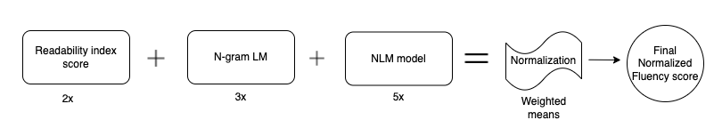
IMPLEMENTATION
We used the MSR Abstractive Text Compression Dataset as corpus. Our plan is to implement the models for measuring the fluency in three different forms.
First we will use rule based measures to measure the textual readability of the sentences in the corpus.
Next we measure the fluency using a statistical model and in the end we measure the fluency using an LSTM NN model.
Then the each score obtained from above three methods is normalized ; and weighted mean average score is calculated.
We compare the new score against human readable scores for analysis.Human readable score we have manually given to the sentences.

Slide 4
How 2 , 3 , 5 Weights are chosen for fluency measurement
We explored 3 different kinds of weight distribution
Readability indices ->2 , statistical LM -> 3 , NLM -> 5
Correlation Coefficient with manual Human Fluency score was 0.519
Readability indices ->1 , statistical LM -> 3 , NLM -> 6
Correlation Coefficient with manual Human Fluency score was 0.429
Readability indices ->1.5 , statistical LM -> 3.5 , NLM -> 5
Correlation Coefficient with manual Human Fluency score was 0.496
As we see best correlation we obtained from weights 2 3 5!

Slide 5
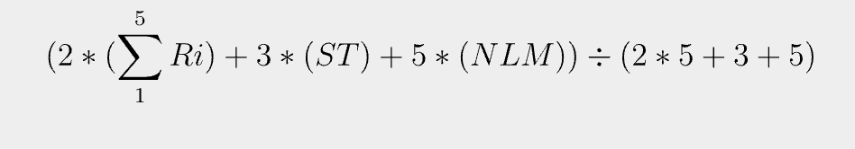
Steps
We will use rule based 5 readability indices, statistical model and neural network model over the same corpus .
So we will have scores from each of 3 above methods.
Then we normalized the score obtained from each of the above 3.
Formula used:
( x - x_{min}) / (x_{max}- x_{min})
Then using weights calculated weighted mean score for each sentence:

Slide 6
Calculating the readability of the corpus using existing readability indices
Applied readability indices to a subset of 15,600 sentences.
Based on readability index, we perceive it as easier to the reader and hence more natural.
Automated readability index
Dale-Chall readability score
Coleman liau index
Linsear write formula
Gunning fog

Slide 7
Calculating the readability of the corpus
We have applied the below readability indices to a subset of 15,600 sentences. These are based on different rules of the given text and help determine the readability, complexity, grade level. Based on the computed readability index, we perceive it as easier to the reader and hence more natural. This might not be a direct measure of textual fluency but is an important metric to measure it. The sentences with high readability indices are more likely to score well on the fluency scale as well.
Automated readability index
Dale-Chall readability score
Coleman liau index
Linsear write formula
Gunning fog

Slide 8
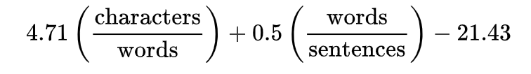
Automated readability index :
where characters is the number of letters and numbers, words is the number of spaces, and sentences is the number of sentences, which were counted manually by the typist when the above formula was developed. Non-integer scores are always rounded up to the nearest whole number, so a score of 10.1 or 10.6 would be converted to 11.

Slide 9
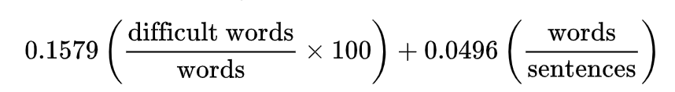
II. Dale-Chall readability score:
It uses a list of 3000 words that groups of fourth-grade American students could reliably understand, considering any word not on that list to be difficult.
If the percentage of difficult words is above 5%, then add 3.6365 to the raw score to get the adjusted score.

Slide 10

III. Coleman-Liau index:
L is the average number of letters per 100 words and S is the average number of sentences per 100 words.
IV. Linsear write formula:
The standard Linsear Write metric Lw runs on a 100-word sample:
For each "easy word", defined as words with 2 syllables or less, add 1 point.
For each "hard word", defined as words with 3 syllables or more, add 3 points.
Divide the points by the number of sentences in the 100-word sample.
Adjust the provisional result r:
If r > 20, Lw = r / 2.
If r ≤ 20, Lw = r / 2 - 1.

Slide 11
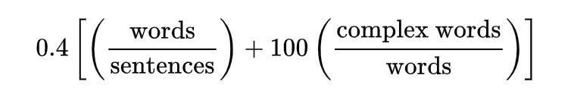
V. Gunning fog index:
Select a passage (such as one or more full paragraphs) of around 100 words. Do not omit any sentences;
Determine the average sentence length. (Divide the number of words by the number of sentences.);
Count the "complex" words consisting of three or more syllables. Do not include proper nouns, familiar jargon, or compound words.
Add the average sentence length and the percentage of complex words
Multiply result by 0.4

Slide 12
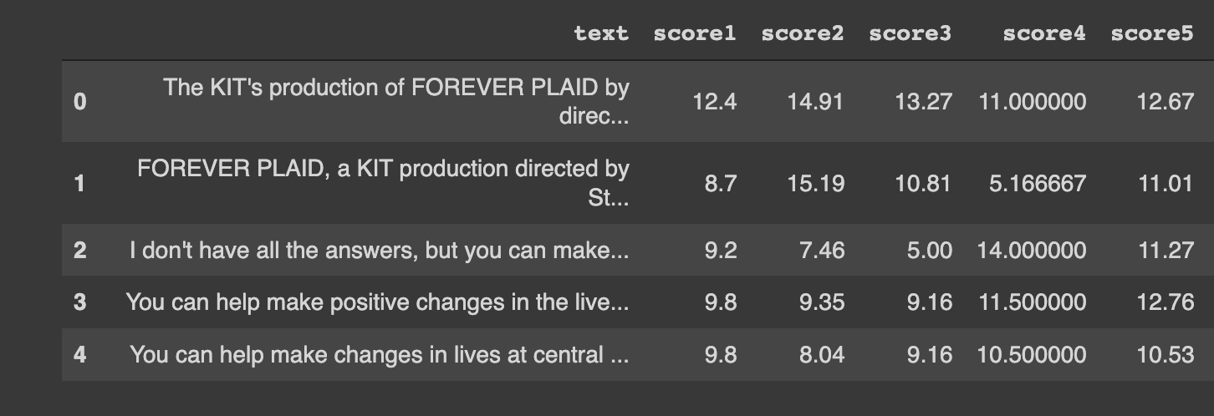
Sample output for readability

Slide 13
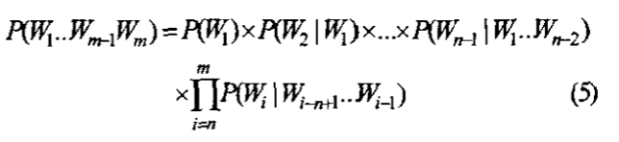
2. Usage of Statistical N-gram LM
IDEA: Use perplexity score of a sentence obtained from N-gram model to judge fluency. This approach does not use any reference translation. Lesser the perplexity score, sentence is more probable and better understandable by the reader.
APPROACH:
N-GRAM MODEL: The n-gram model is used to predict the probability of a word by the left contextual words. In the n-gram model, we consider a sentence as an order Markov chain, where a word‘s probability is predicted only by the n-1 words to its left. The formula to calculate the probability of sentence using n-gram model:

Slide 14

2. SMOOTHING: Modified kneyser ney smoothing is done to move some probability to the unkown N-grams.
3. Using N-gram conditional probability:
Take the first term w1 of a sentence, and lets say it is a high frequency word. A high score will be assigned to the sentence. But this is not always true, the probability that the sentence starts with w1 might be very low. This results in loss of fluency. So we replace P(w1) with P(w1| PSE) where PSE denotes the punctuations used in the end of a sentence such as full stops, question marks and so on. Using P(w1| N-gram) to denote the CP of different n-grams in a sentence, the formula is written as:

Slide 15
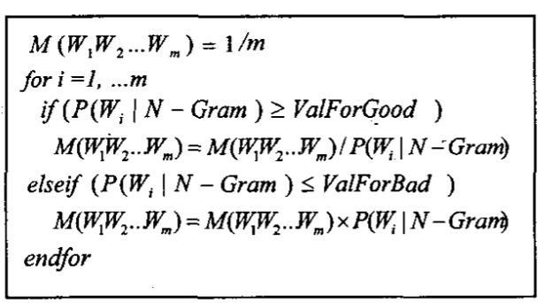
4. SENTENCE FLUENCY:
Only few trunks of a sentence make it ill-formed. Since our aim is to select these bad sentences from good ones, we don’t need to multiply all the n-grams of a sentence but only to multiply those strange ones.Thus we multiply the CP of those strange n-grams and call the result as penalty value. We multiply the CP of those good n-grams and call the result as praise value. Fluent sentences will have a high penalty value and a low praise value while the ill formed sentences will have a low penalty value and a high praise value. Thus, we divide the penalty value by the praise value and use the result. The fluency of a sentence is calculated using the below algorithm:
Here ValForGood and ValForBad is selected as follows:
Sort the conditional Probabilities obtained from the N-GRAMS.
ValForGood is taken as the lowest conditional probability of the first 40 percent of probabilities and ValForBad is taken as the highest conditional probability of the last 20 percent
In our implementation we have replaced probability with Perplexity to show better readable results.

Slide 16
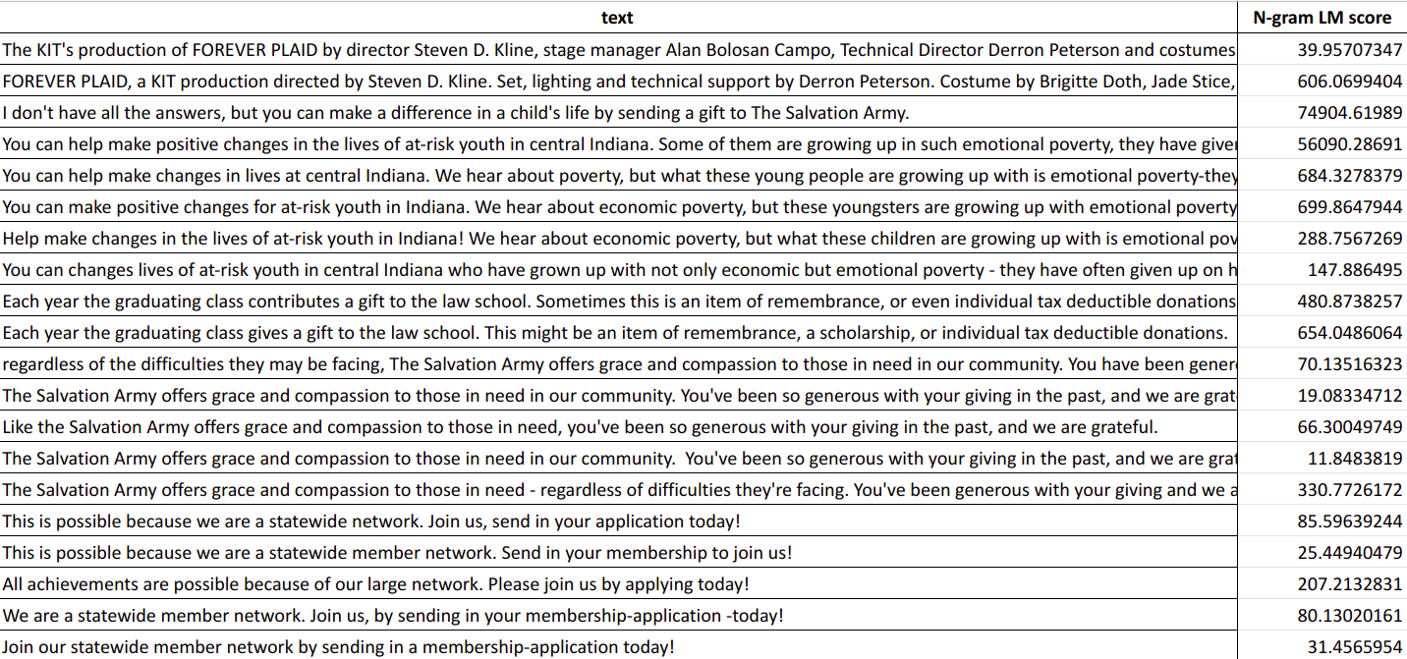
Sample output : statistical n-gram LM

Slide 17
3. Usage of LSTM neural network based language model
Then input dimension is determined from vocab size and One hot encoding for each word in each sentence is fed to language model
Parameter | Value
Number of Sentences trained on | 6000
Vocab size | 9301
Number of Sentences tested on | 4000
Dimensions of LSTM | 12
dropout layers | 2
Activation functions | relu and softmax
epochs | 12

Slide 18
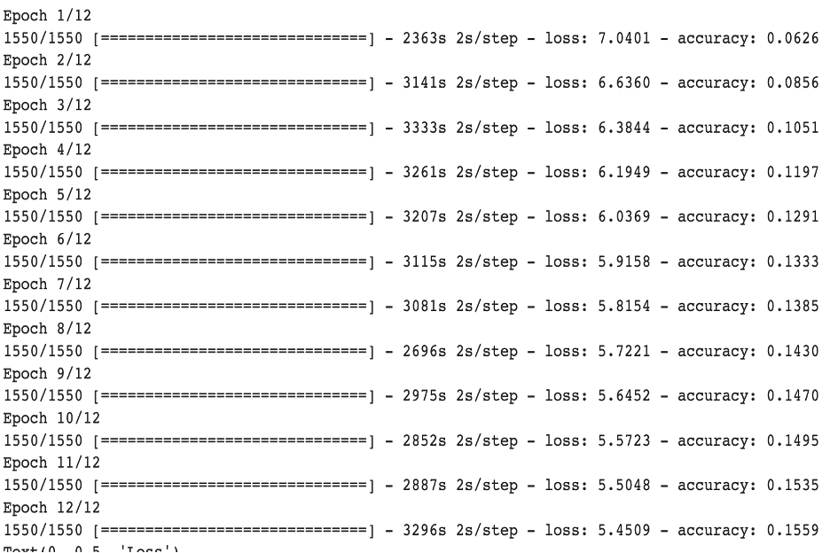
Training output

Slide 19
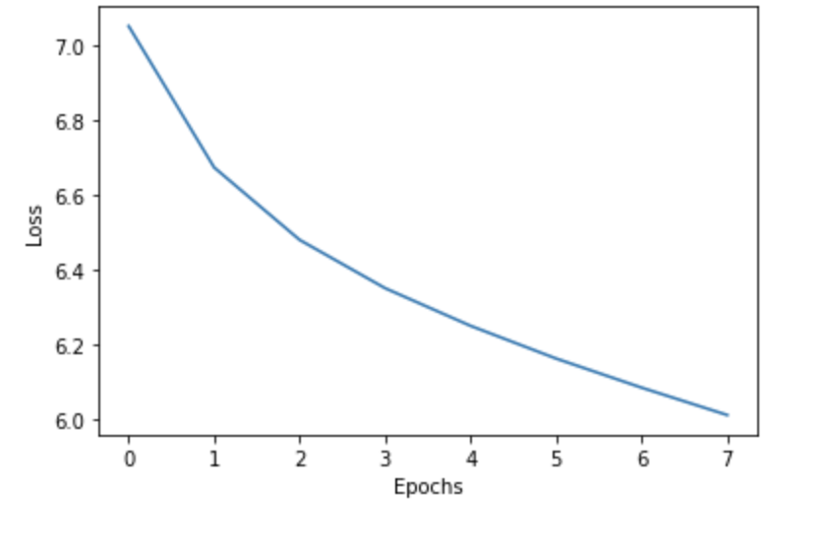
Loss Graph
Sample perplexity scores are given in next slide.

Slide 20
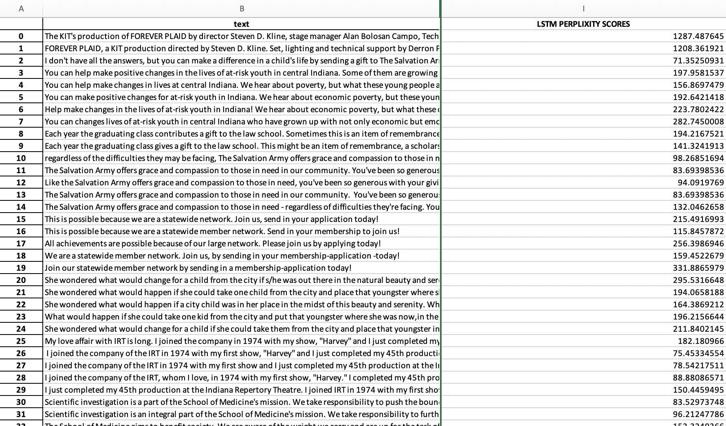

Slide 21
Deriving new formula for fluency
We will use rule based 5 readability index scores, statistical model scores and neural network model scores over the same corpus for each sentence .Then we will normalize each score.Then get a weighted mean score combining all the scores to get best score.Maximum weight is given to the NLM model.
Weights are assigned like below:
For readability index score -> weight of 2
For statistical model score -> weight of 3
For NLM model score -> weight of 5
Then each weighted mean score is scaled to 10 ; low score means better in fluency and can be perceived better.

Slide 22
Human fluency scores
Then we randomly selected 100 sentence from corpus;and manually calculated Fluency score from scale of 1 to 10 following below rules:
v complex words , sentence length high | 8+
v complex ; sentence length short | 7 - 8
complex ; sentence length high | 5-6
complex ; sentence length short | 4-5
less complex/easy ; sentence length high | 3-4
less complex/easy ; sentence length short | 2-3

Slide 23
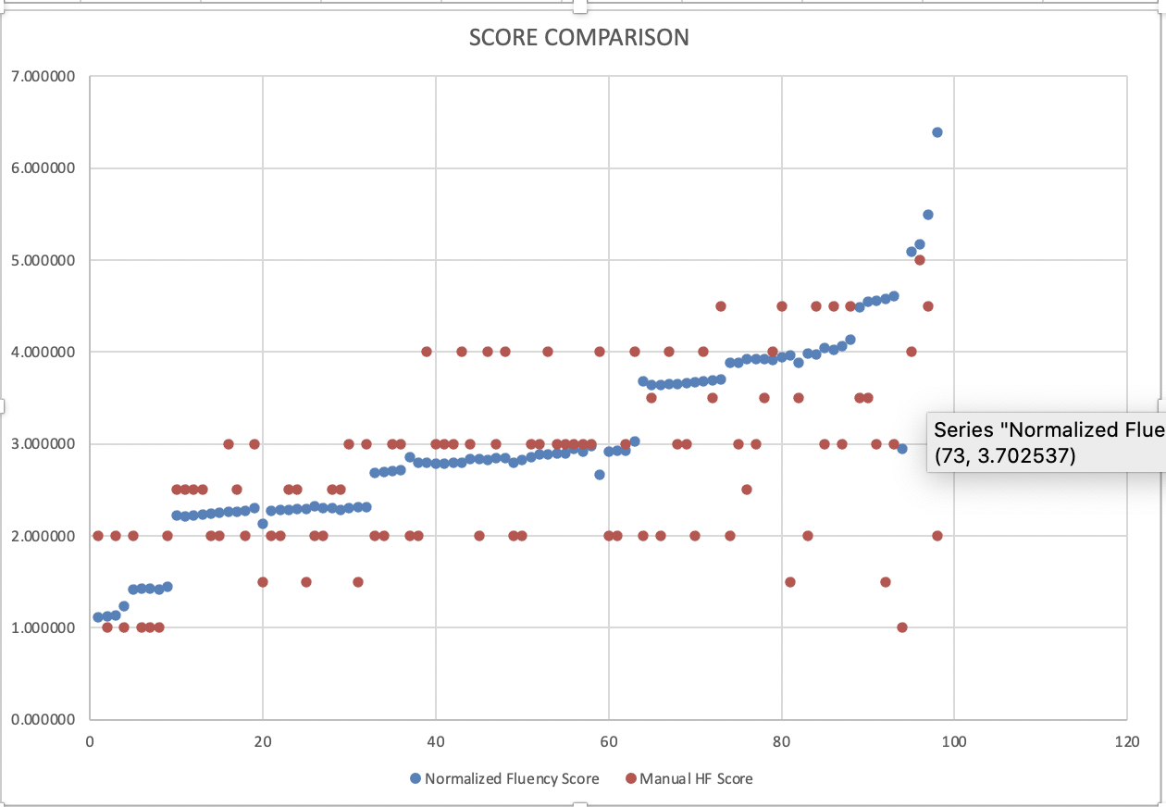
Comparing human fluency scores with weighted means score
Manual human fluency scores were in range of those detected by experiment.

Slide 24
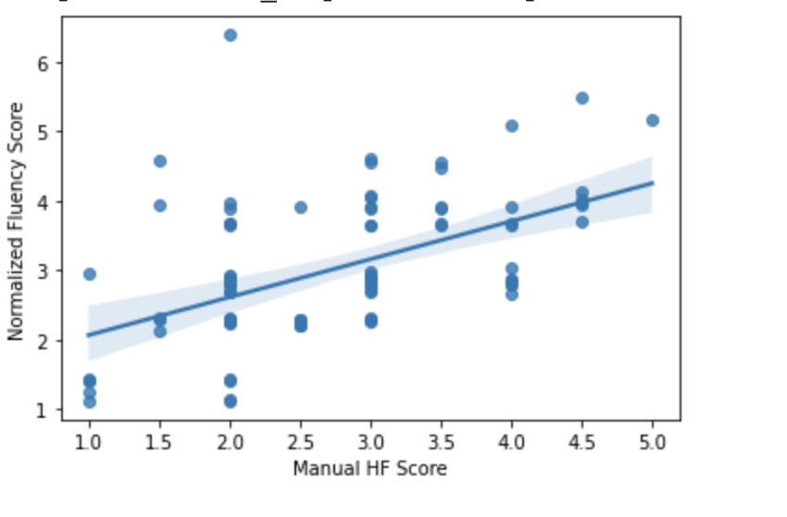
Correlation graph

Slide 25
SUMMARY
We have used rule based readability indices, statistical model and neural network model over the same corpus to understand the complexity and fluency of sentences.
Then we compared the weighted mean score with manual human fluency scores for 100.

Slide 26
Thank you

